Slide 1
DOELAP Assessor Training
Using the Checklist
Idaho Falls, ID
September 2023

Slide 2
DOELAP External Dosimetry Checklist
The checklist can be found at the RESL DOELAP web page or in the email from Laird
  https://www.id.energy.gov/resl/doelap/doelap.html
  https://www.id.energy.gov/resl/assessordata/dosimetry/audit sites/PNNL/2021A/PNNL.html
Based on DOE-STD-1095-2018
  https://www.standards.doe.gov/standards-documents/1000/1095-astd-2018
The checklist is not a normative document
  Findings are written based on Standard requirements
  Checklist is a tool for the assessor
  Personal checklists can also be used
  Additional notes in another form or location are fine

Slide 3
DOELAP External Dosimetry Checklist
Portions of the checklist can be evaluated and filled out in advance
Assessment team sends in a completed checklist with the signed assessment report and attendance sheets
  Defensibility if there are questions about whether something was evaluated
  Place your initials at top of page
  N/A column or page
Findings are written based on the Standard reference, not checklist
  This wasn’t always the case in DOELAP, but is the guidance now
  Findings database

Slide 4
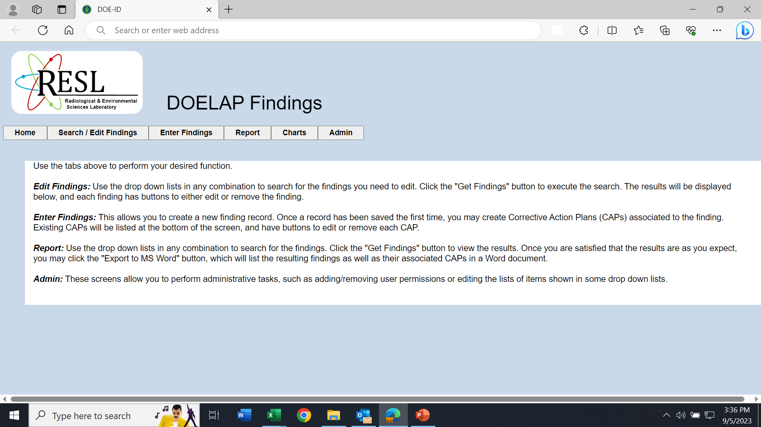
DOELAP Findings Database

Slide 5
Histogram of DOELAP Findings

Slide 6
Discussion on Checklist Use
How do assessors use the checklist?

Slide 7
Questions?

